Slide 1



AI-DRIVEN RECRUITMENT PLATFORM
Team
1. Lakshya Garg(E23CSEU1841) 2. Satya Prakash(E23CSEU1845)

Slide 2

AI-DRIVEN RECRUITMENT PLATFORM
An AI-powered hiring assistant that streamlines resume screening, recommends top candidates, schedules interviews, and delivers insights making recruitment faster, smarter, and bias-free.

Slide 3

INEFFICIENCIES IN TRADITIONAL HIRING
Manual resume screening takes hours
High chances of human bias
Poor candidate engagement & experience
Ineffective interview scheduling methods
No real-time data insights
Limited tools for predicting job fit

Slide 4
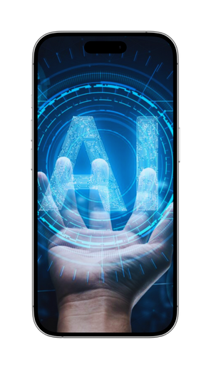
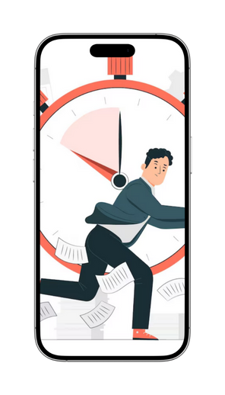
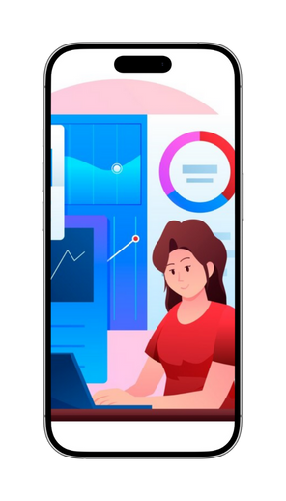
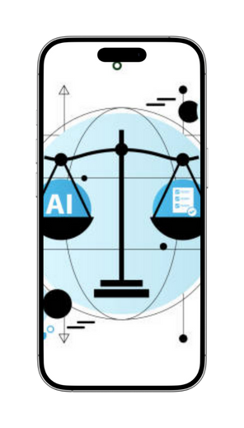
PROJECT OBJECTIVE
AI-Powered
Faster Hiring
Data-Driven
Bias-Free

Slide 5

DESIGN THINKING PROCESS
Understood hiring issues through user research
Defined recruitment problems in clear terms
Ideated smart solutions using AI tools
Prototyped dashboards, chatbot, and workflows
Tested features with real-time user feedback
Refined based on insights and reviews

Slide 6
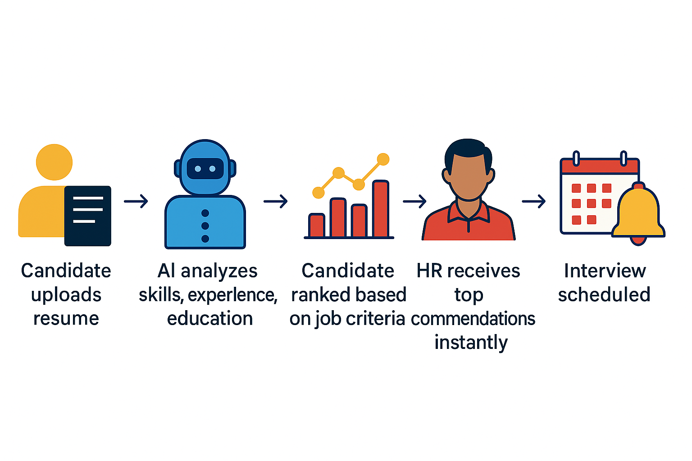
PROPOSED SOLUTION

Slide 7
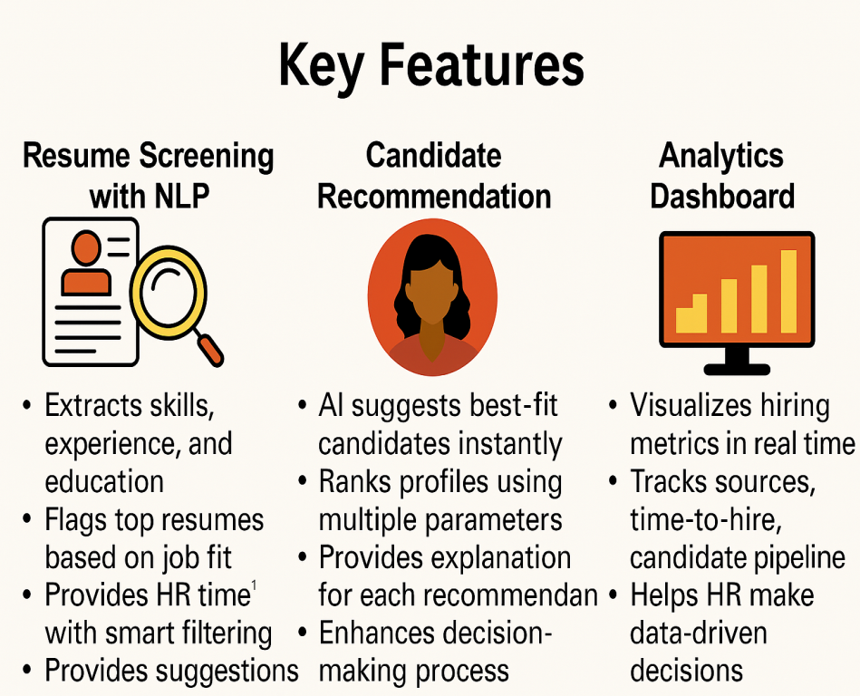


KEY FEATURES
Extracts skills and experience
Flags top job-matching resumes
Smart filtering for quick review
Suggests resume improvements to candidates
AI ranks best-fit profiles
Matches based on job needs
Explains each recommendation clearly
Learns from HR decision patterns
Visualizes recruitment performance metrics
Tracks sources and hiring timeline
Supports data-driven HR decisions
Detects hiring process bottlenecks

Slide 8




TECH STACK

Slide 9
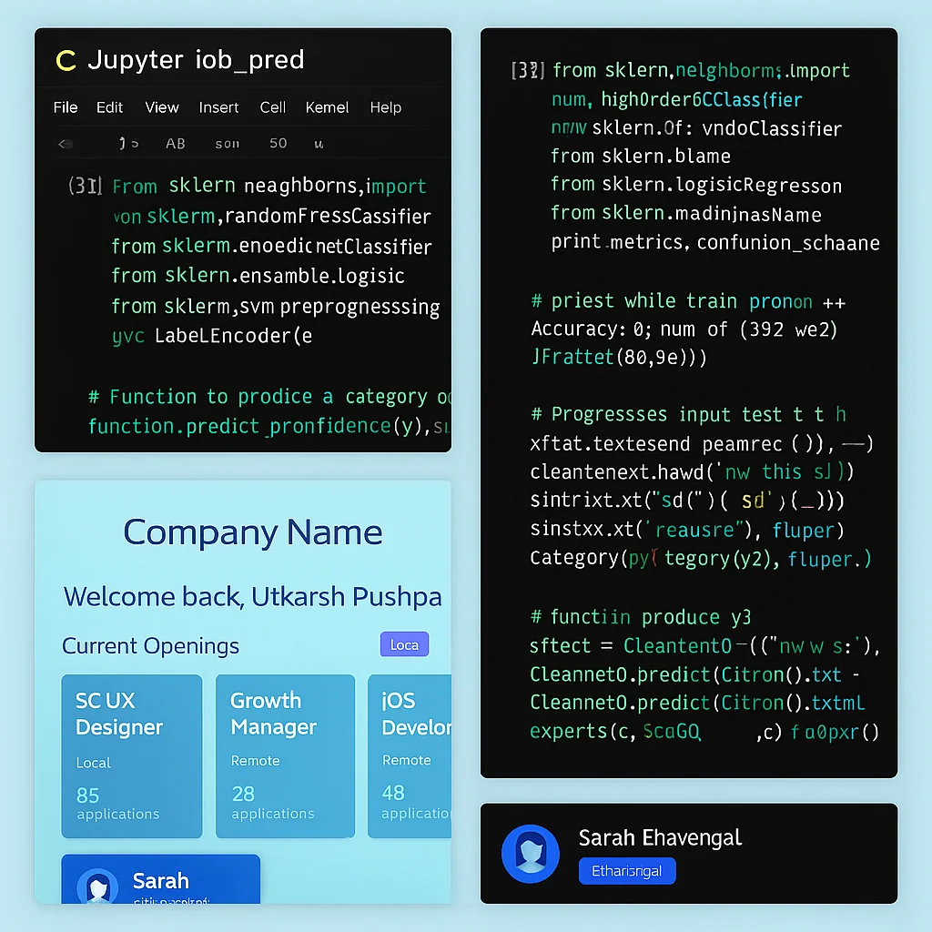
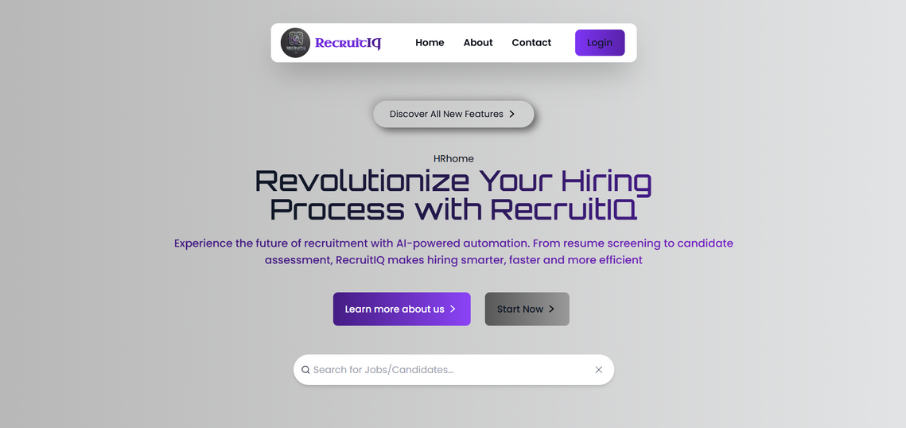
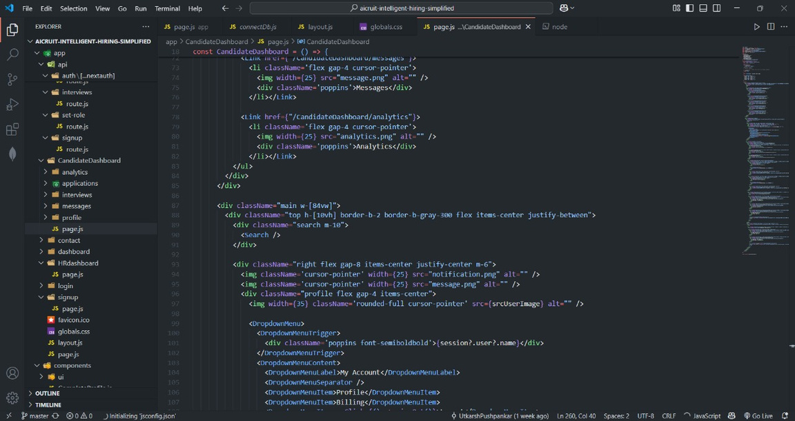
CODE SNIPPET

Slide 10

CHALLENGES WE FACED – AND HOW WE SOLVED THEM
Inconsistent Resume Formats - Structured with NLP pipelines
Limited HR Domain Knowledge - Studied real hiring processes
Limited Training Data - Used open & synthetic data
Parsing Accuracy Issues - Applied pre-cleaning & model tuning
Unintuitive UI Design - Redesigned with user feedback
Time Constraints & Team Sync - Weekly syncs & task tools

Slide 11
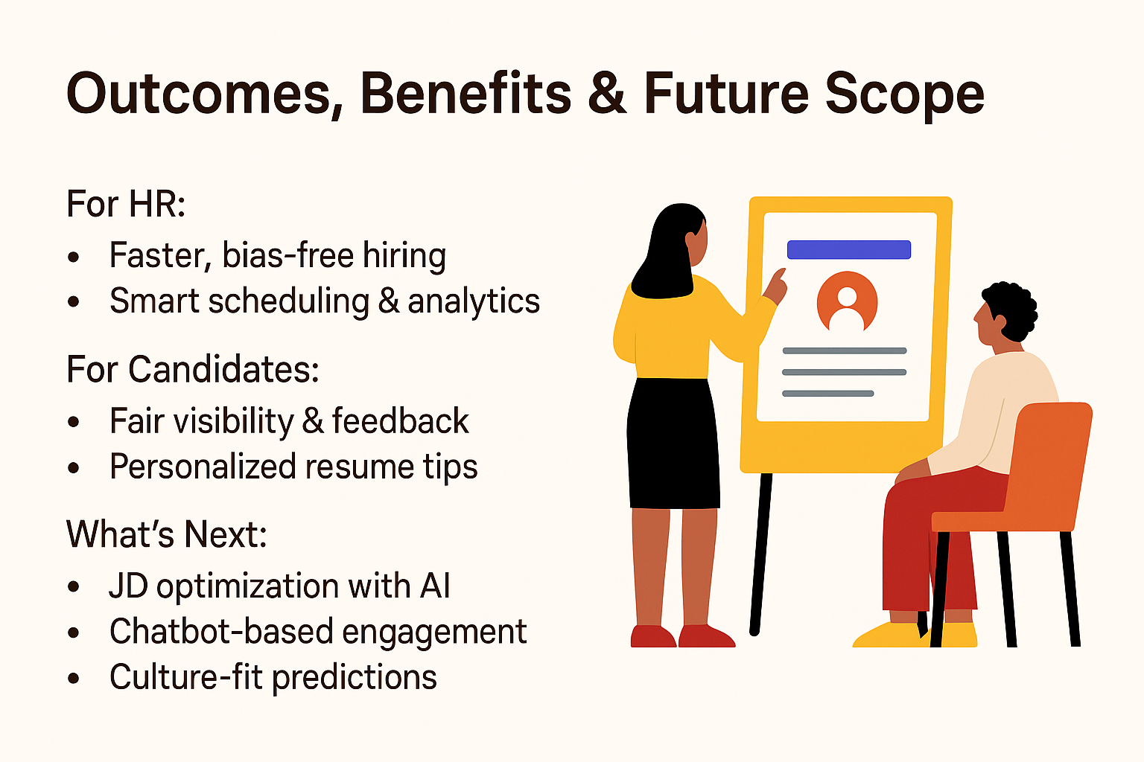
OUTCOMES, BENEFITS & FUTURE SCOPE
Faster, smarter candidate shortlisting
Bias-free, data-backed recommendations
Personalized feedback on resumes
Improved visibility & fair evaluation
Chatbot-driven candidate engagement
Sentiment analysis in video interviews

Slide 12

THANK YOU

